Slide 1
Knowledge Versus Wisdom
Balancing Western Science and Indigenous Practice
By Rick Hill

Slide 2
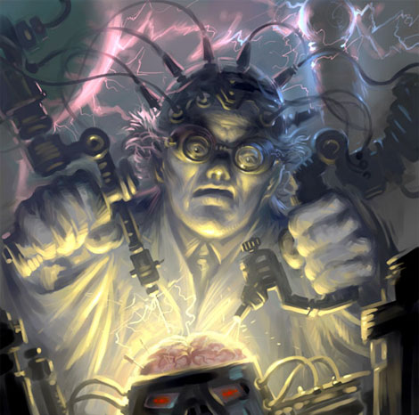
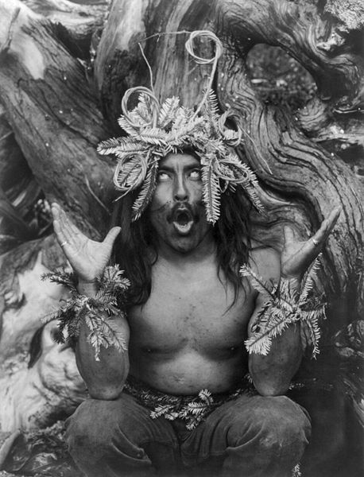
Mad Scientist or Witch Doctor?
If you needed help which would you chose?

Slide 3
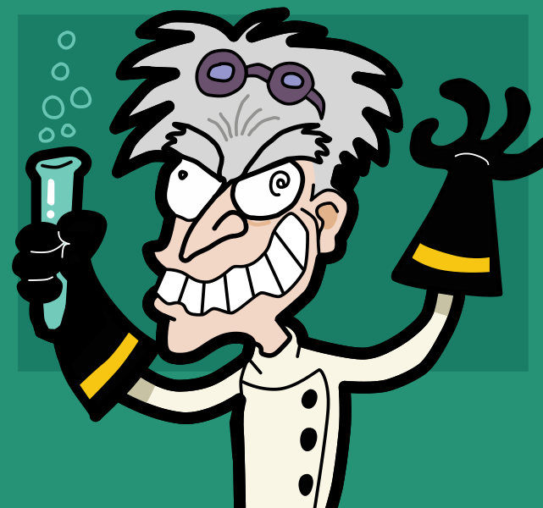
Mad Scientist?
Can Scientific Ecological Knowledge (Western Science) save the world?
Or, will it destroy it?

Slide 4
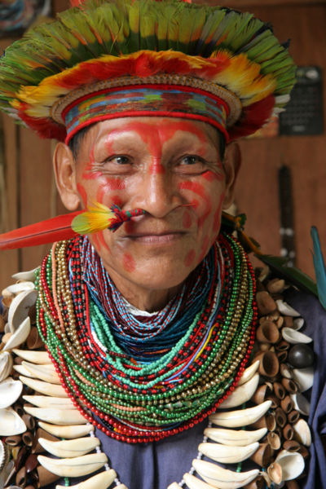
Witch Doctor?
Can Indigenous Ecological Wisdom (Human Conduct) save the world?
Is it too late for the practices that were once considered primitive and pagan to make a difference?

Slide 5
Knowledge Versus Wisdom
Knowledge is about information, facts, theories and predicable outcomes.
Wisdom comes from centuries of putting Indigenous knowledge into practice and then creating a way of life based upon the results.

Slide 6
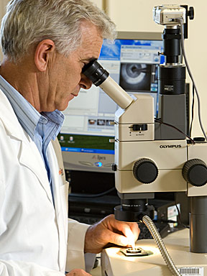
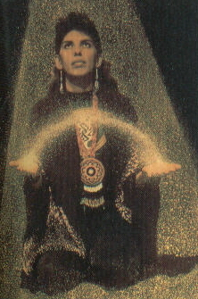
Are Scientific Knowledge and Indigenous Wisdom Incompatible?

Slide 7
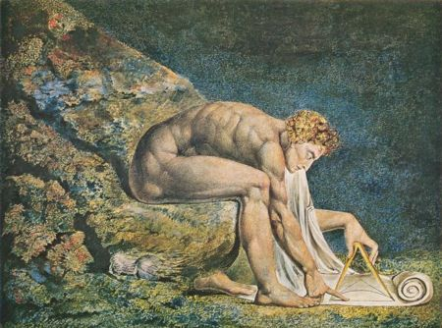
Nature and Nature's laws lay hid in night
God said Let Newton be! And all was light.
William Blake was opposed to scientific materialism. He rejected the great philosopher-scientist who is so intent on his compass at the bottom of the sea he becomes oblivious to the world around him.

Slide 8
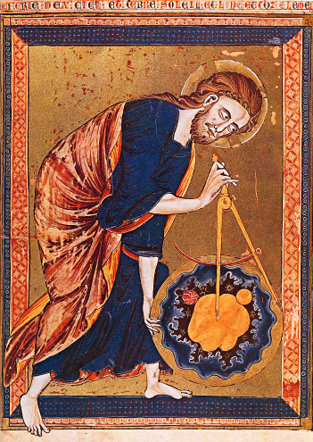
Geometry of Creation
The compass in this 13th century manuscript is a symbol of God's act of creating the universe after geometric and harmonic principles; to seek these principles was therefore to seek and worship God.

Slide 9
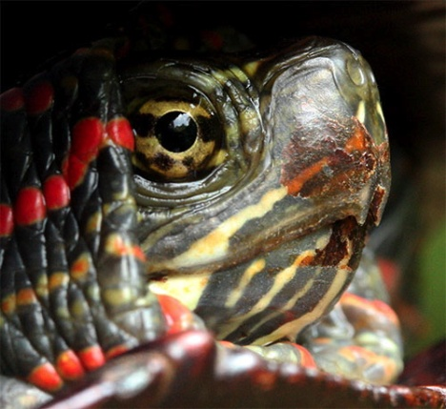
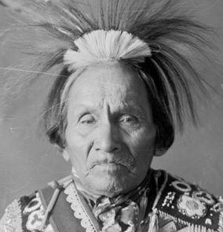
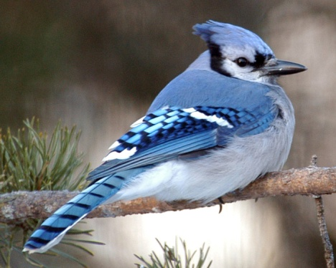
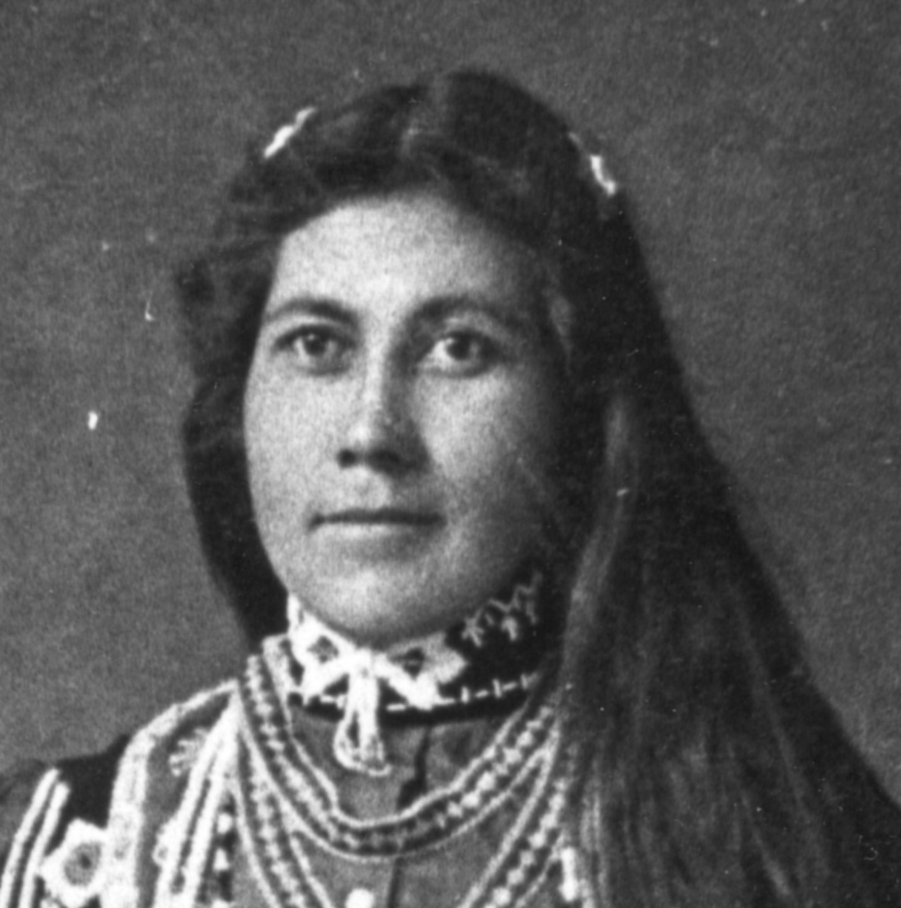
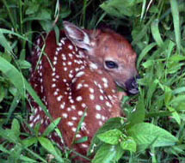
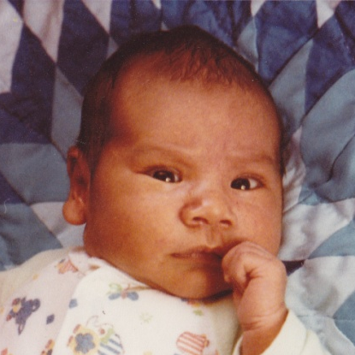
Our Green Traditions
Lessons of the Creation Story
The Original Instructions
The Dish With One Spoon
Giving Thanks
The Seventh Generation

Slide 10
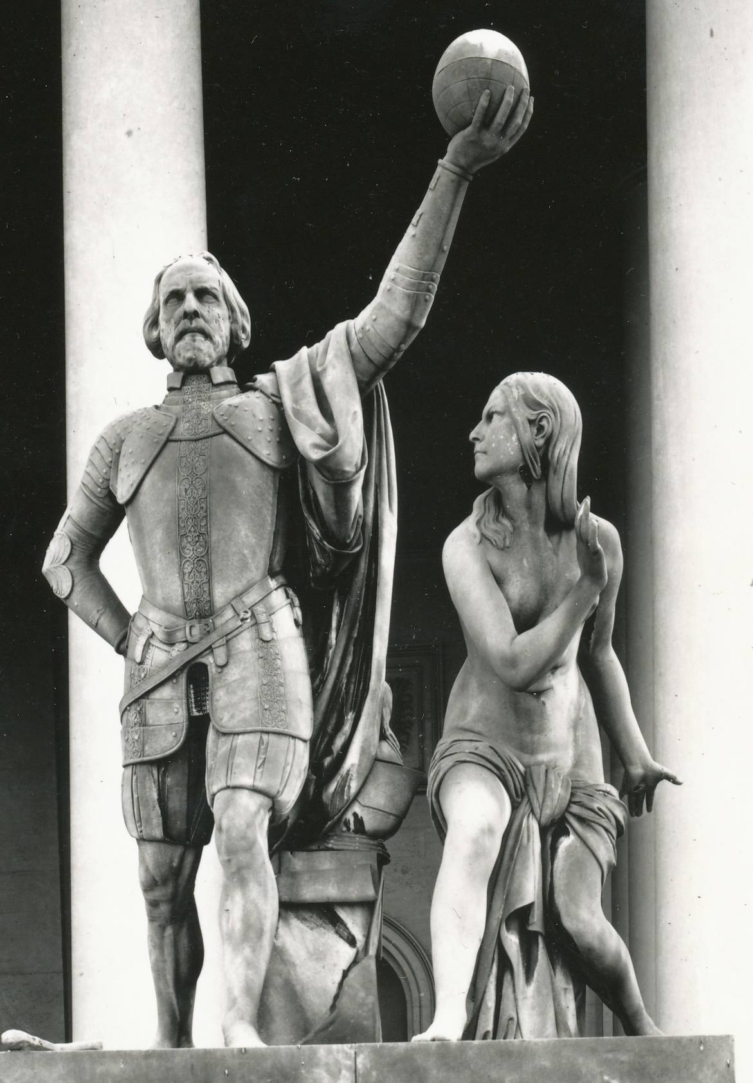
Two Worldviews Collide
Columbus lifts a globe overhead as the nearly native woman cowers in response.
Europeans could not see the value of native cultures, driven by their own desires.

Slide 11
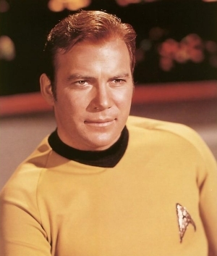
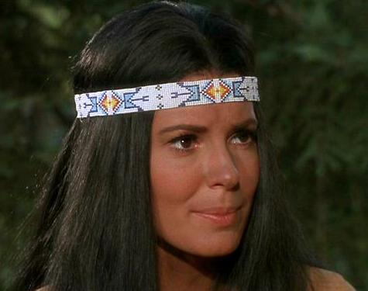
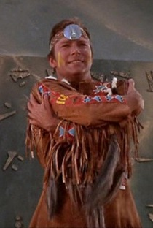
Paradise Syndrome
Captain Kirk of the star ship Enterprise discovered a strange new world, filled with buckskin clad people, living in tipis, wearing feathers and beads and thought he was a god.
He married High Priestess Miramanee and suffered from Paradise Syndrome – the need to save the savages from themselves.

Slide 12
New Colonization?
While their worldwide attention now being given to Traditional ecological knowledge, it seems like a new form of colonization, where our ideas and beliefs will be harvested and turned into a commodity.
Such knowledge is already viewed as cultural or intellectual “property” which can be copyrighted.

Slide 13
Two Views
“Sustainable development is development that meets the needs of the present without compromising the ability of future generations to meet their own needs.”
Brundtland Definition – 1987
Is this similar to the "seventh generation" philosophy of the Haudenosaunee, mandating that chiefs always consider the effects of their actions on their descendants seven generations in the future?

Slide 14
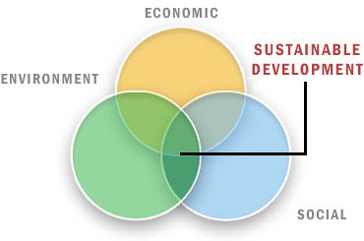
Sustainable Development?
John Moores University Model
We seek a balance of interests, but assume that development will continue.

Slide 15
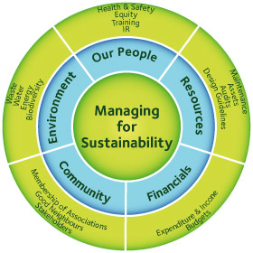
Is Sustainability Sustainable?
Western Ecological Knowledge believes that humans can manage ecology.
Indigenous Ecological Wisdom teaches us we are managed by nature.

Slide 16
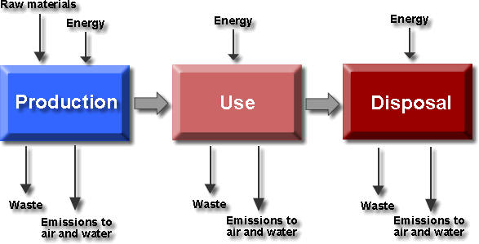
Waste is the triple bottom line that modern life cannot seem to control effectively enough to assure healthy water, land and air for the Seventh Generation to come.

Slide 17
Customary Uses
Indigenous societies have a reciprocal relationship with “natural resources” as part of a large extended family.
Our Customary Use was to make sure there would be “resources” for the future generations by not over harvesting.
However, even our own practice needs improvement.

Slide 18
Cree Point of View
Sustainable use of resources by the Cree of the subarctic region of Canada can be demonstrated by three facts:
None of the species used by Cree has gone extinct since the glaciers departed 4000-5000 years ago.
All species in harvest are at present found in healthy populations.
No evidence is found of damage to ecosystem structure due to culturally-based practices.
(Berkes 1998, p. 99).

Slide 19
Associated Cultural Practices
The Cree respect the physical and spirit aspects of the plants, animals, birds and fish.
That respect encouraged the creatures to share their bounty, and enrich us with their energy.
Cree ceremonies maintained and taught that respect, children grow knowing no other way of being.
Cleanliness of the Cree camp was one way in which to show respect.

Slide 20
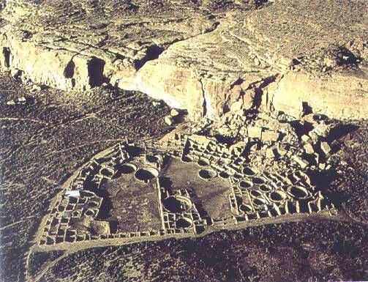
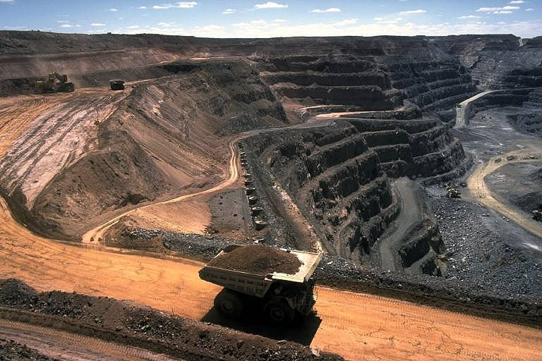
Hopi Point of View
The Hopi know that life on earth was once destroyed by a great flood. Those who survived made a sacred covenant with the Great Spirit to never turn away from the instructions that he gave the first humans.

Slide 21
Hopi Prophesy
“So as our prophecy says, then it must be up to the people with good and pure hearts that will not be afraid to help us to fulfill our destiny in peace for this world. We now stand at a cross roads whether to lead ourselves in everlasting life or total destruction,” states Hopi elder Dan Evemhema.
There were no racial or disciplinary boundaries placed upon what kind of people might help.

Slide 22
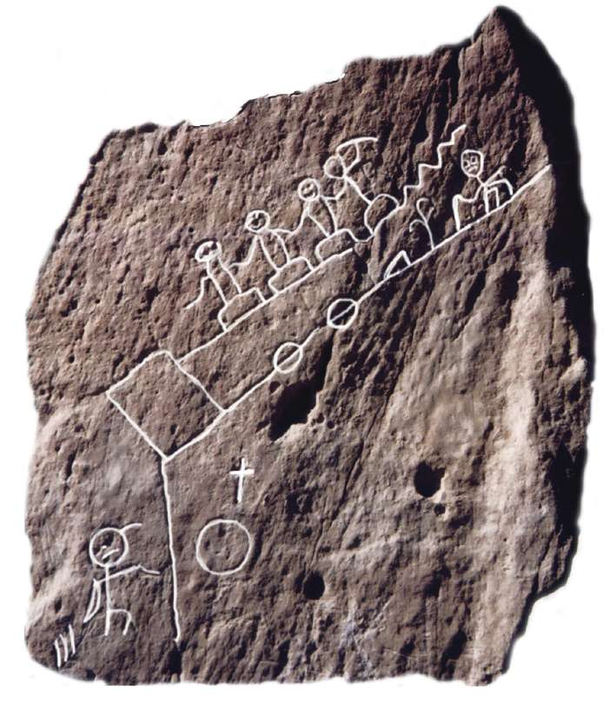
Prophesy Rock
The Hopi Prophecy Rock depicts two ways of being, one that leads to peace and happiness. The other that leads to death and destruction.
The good minded path on the bottom is that of the One-hearted People – those who have kept Indigenous wisdom alive and viable and will grow old still planting corn.

Slide 23
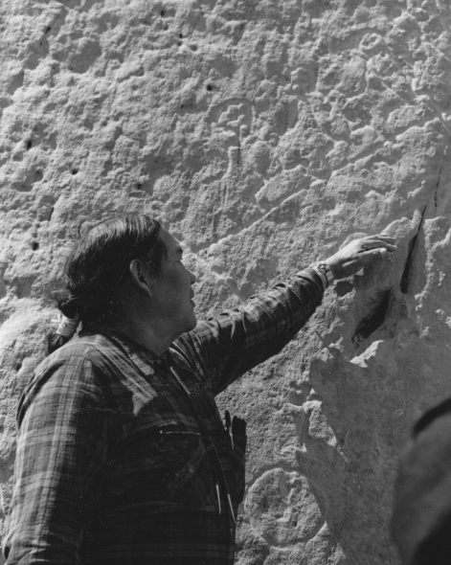
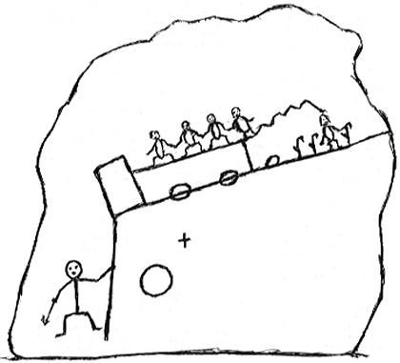
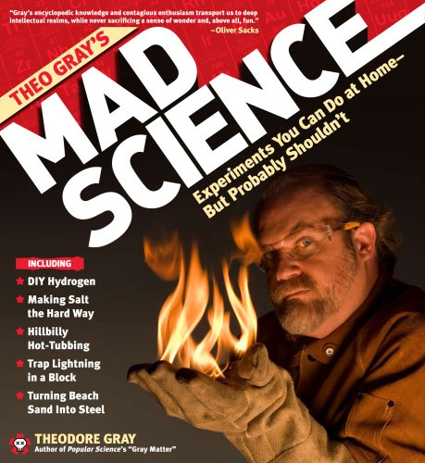
Two-Hearted People
The not-so-good minded path is that of the Two-hearted People – those who have lost their spirit balance and have invented things that might cause the destruction of life, and travel on the upper, crooked path.
A two-hearted person is one who thinks with his head rather than his heart.

Slide 24

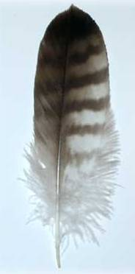
Our Response?
What are we going to do about this?
We could become depressed and turn to mind-changing substances to alleviate the pain.
We could attend to our ceremonies in the hope that it will turn the tide for others.

Slide 25
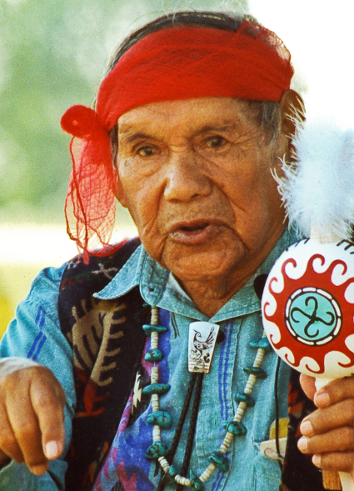
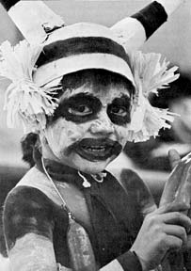
Hope for the Future
If the two-hearted people persist in living in ignorance, it will lead to chaos and self-destruction (jagged path).
If they chose to think with their hearts they would gradually return to the natural way and their own survival.
The Hopi believe it is their duty to help the scientists learn more of their spiritual obligations to the earth.
They ask: What is your direct relationship with the earth?

Slide 26
Haudenosaunee View
We are intimately bound to how the earth works and our lives are interdependent with nature.
We cannot be healthy unless the earth is healthy. The earth cannot be complete unless we are healthy.
We are to walk lightly on the ground for the faces of the coming generations are within the surface of the earth.

Slide 27
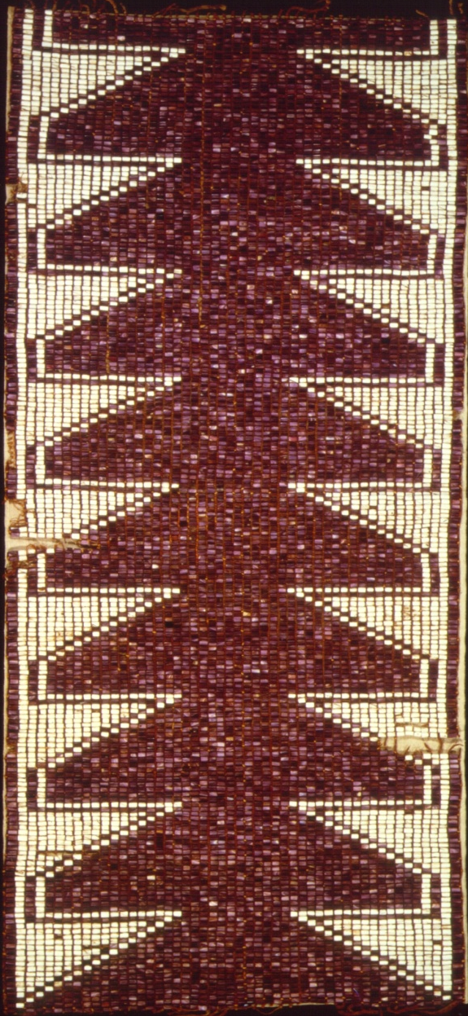
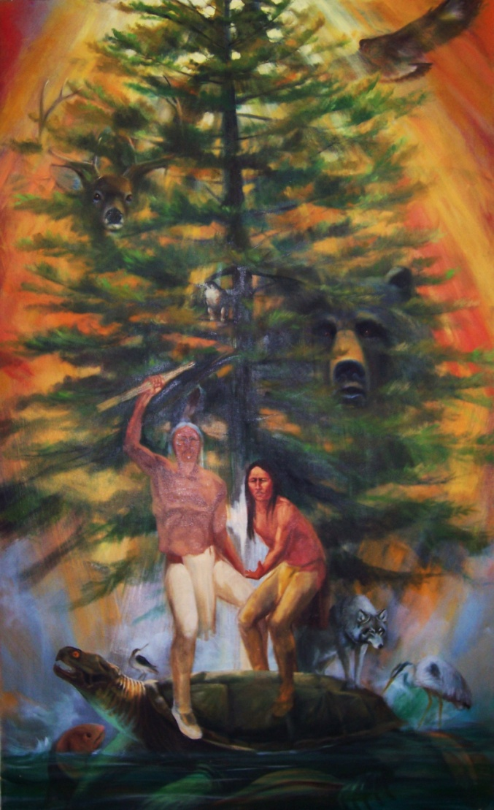
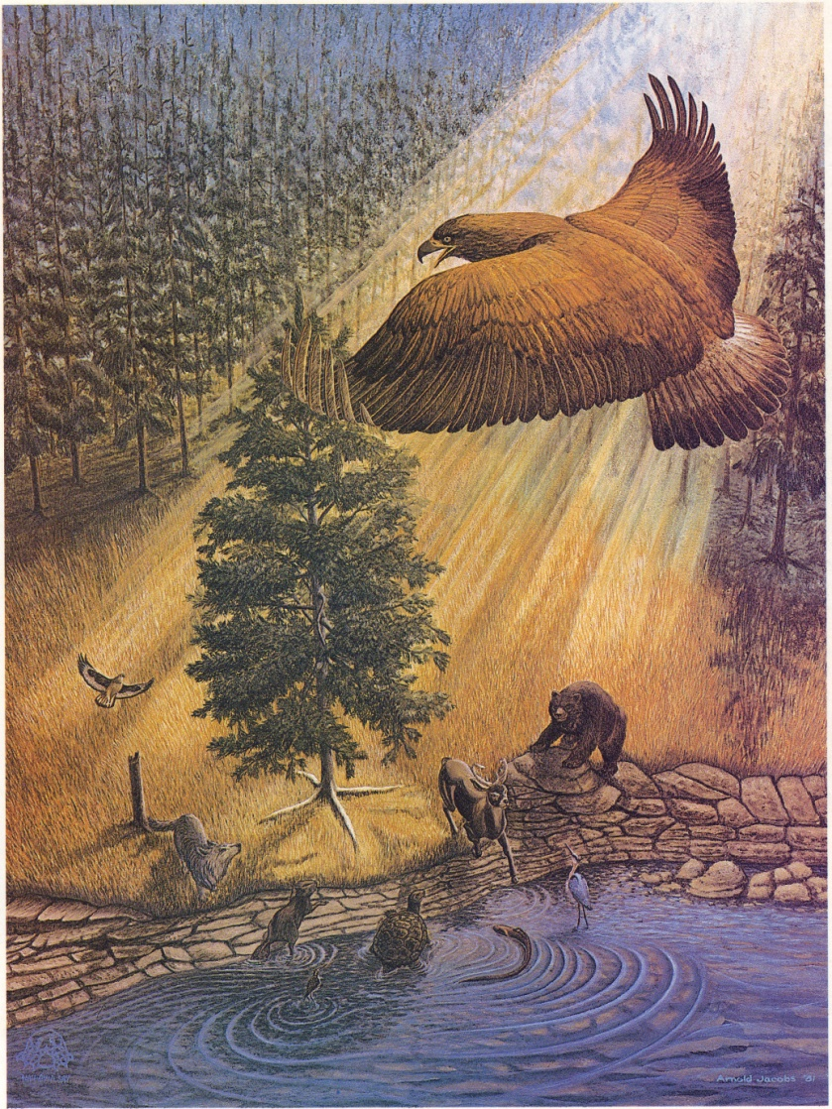
Respect for Trees

Slide 28
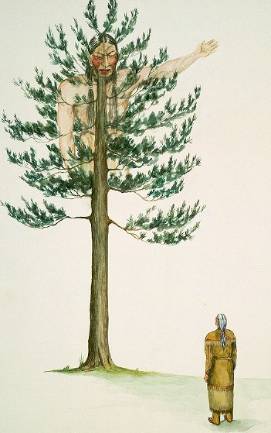
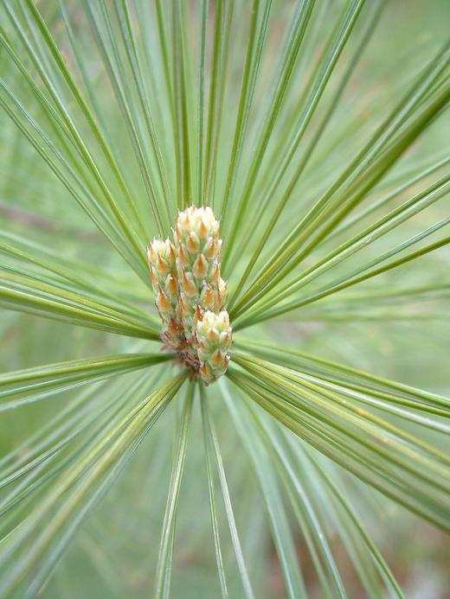

Slide 29
Tree Knowledge
It is not a matter of how many trees you save, plant or carve into trinkets.
It is about the quality of your personal relationship to the trees that are left.
Indigenous wisdom teaches us that trees are born to die, but along their journey they can share their knowledge, wisdom and spirit.
So listen to the trees.

Slide 30
Dish With One Spoon
Nature is like a huge bowl from which we draw us sustenance.
We all have an equal right to it.
We all have a responsibility to keep the bowl clean and the resources healthy.

Slide 31
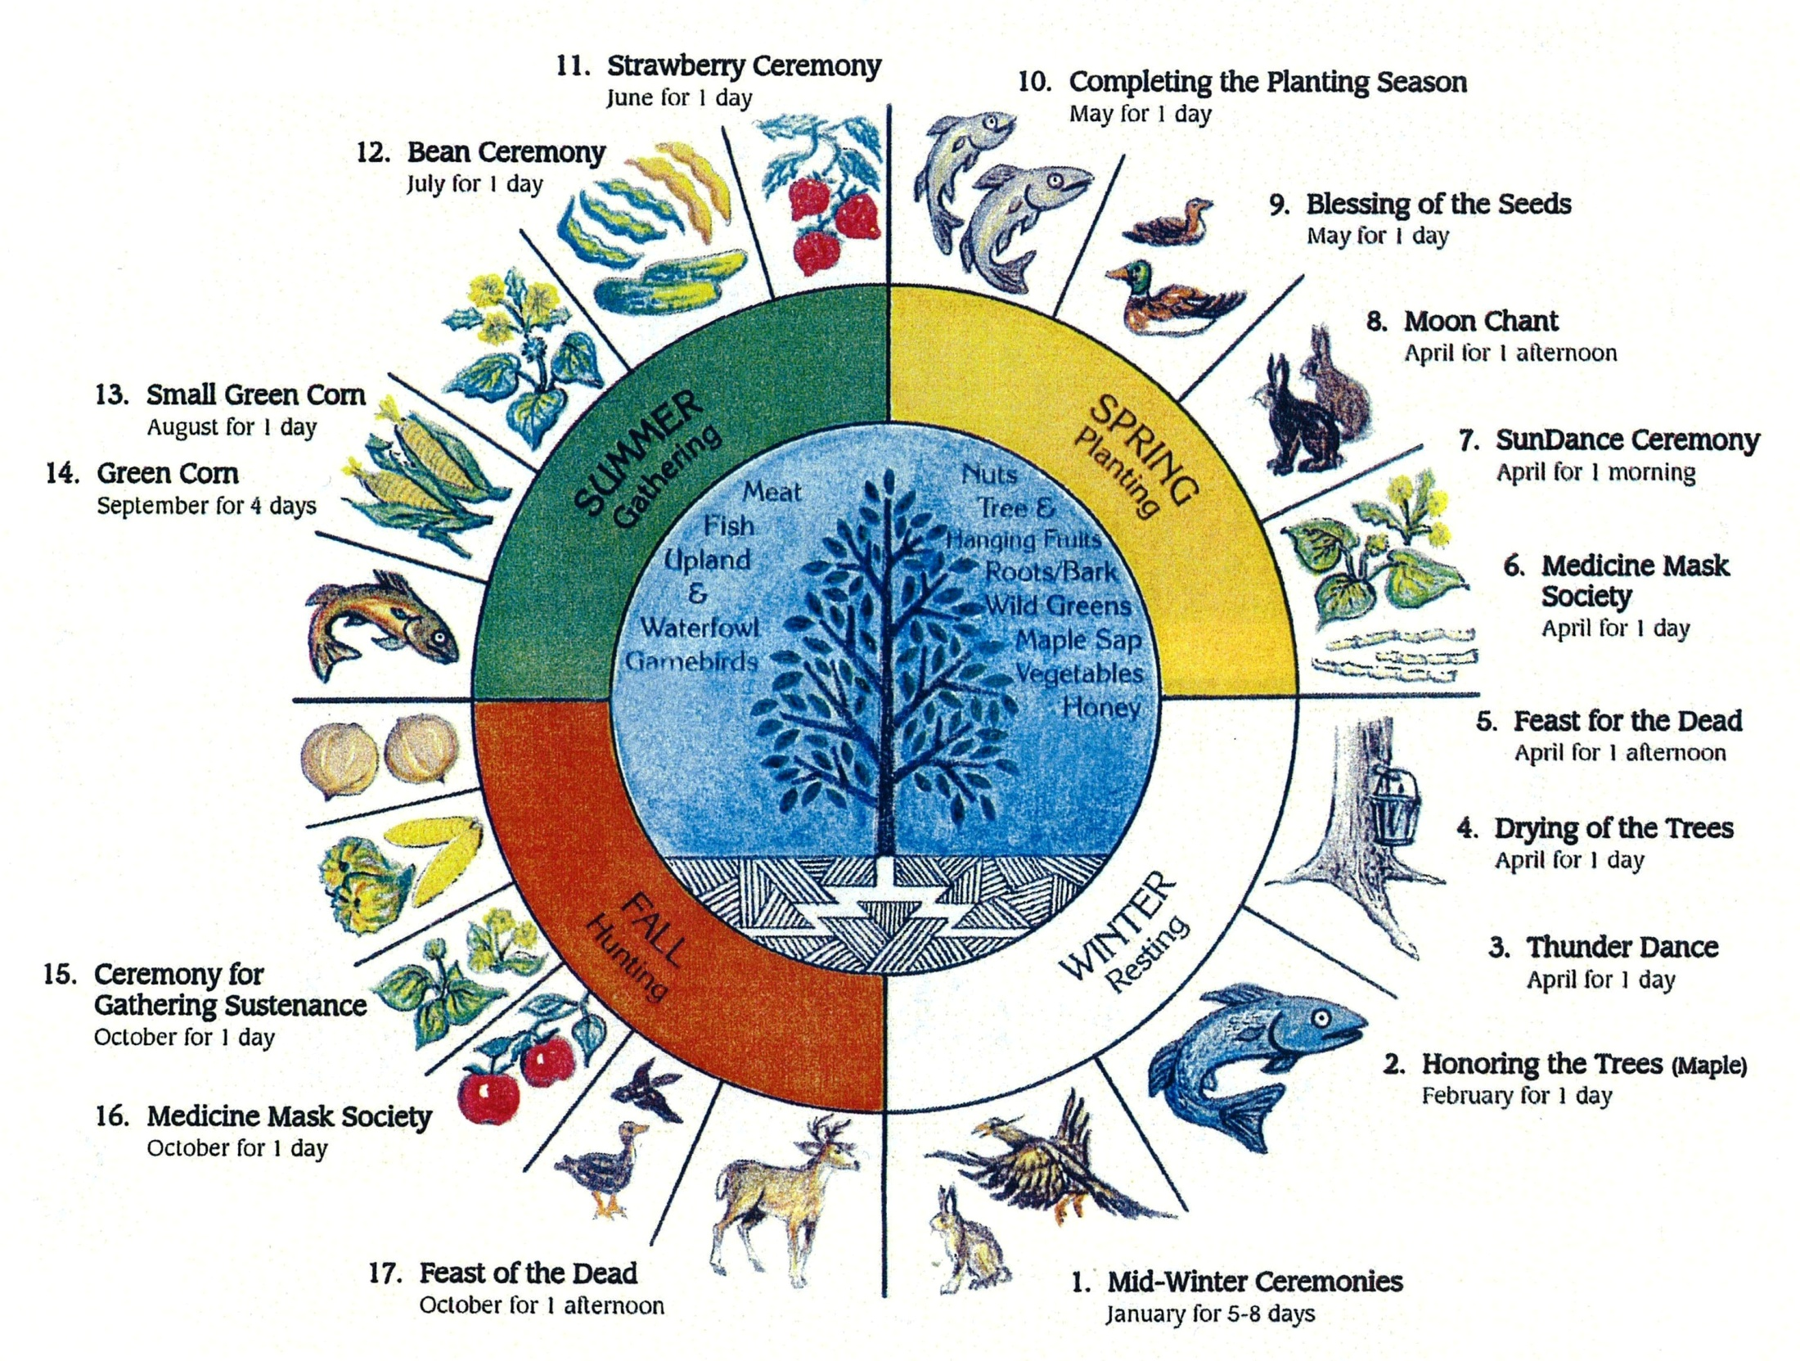

Slide 32
Collective Wisdom
Collective Wisdom comes from experiencing the same place for countless generations, and expressing that knowledge in story, art, song and ceremony.
It is the wisdom of the Ancient People, combined with the wisdom of the historic peoples, added to the wisdom of today.
Each generation follows the path laid out for them, but learns to navigate on that path in theirm own way.

Slide 33
Original Instructions
Be Thankful.
Be kind to one another.
Continue on the path set out for us.
Think of the future generations.
Tell stories of what took place.

Slide 34
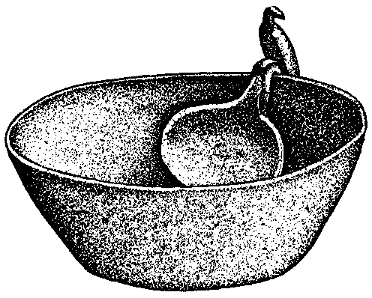
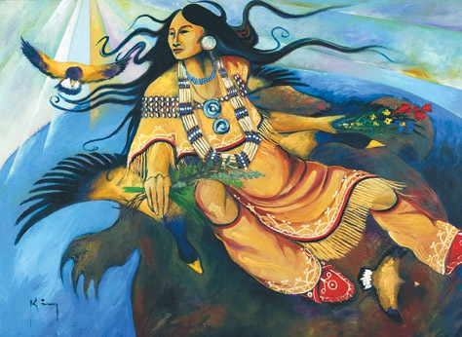
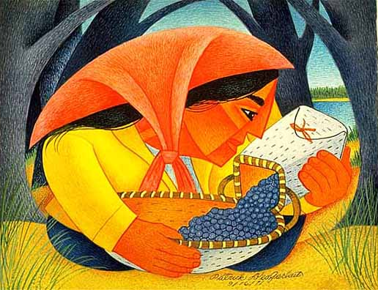
Dish With One Spoon
Our idea of stewardship is actually a very old idea known as the Dish With One Spoon – an ideology that was said to be the first treaty among the Native Nations of North America.

Slide 35
Dish With One Spoon
We agreed to share the resources of the land to which we all have an equal right. The Great Dish – a bowl that holds what the land and waters provide for our healthiness – is a sacred trust and an ongoing responsibility for all.
However, in order to assure that the Dish will be able to serve many generations to come, we are to apply our Indigenous Ecological Wisdom and only take what we need to feed and care for our families.

Slide 36
Two Rows of Knowledge
The Two Row Wampum tells us that you can’t put one foot in the native canoe and the other foot in the white man’s ship.
The vessels will push apart and you will fall in to the dark, dangerous waters in between.
No power on earth can rescue you.
Does that also mean you can’t mix Western Science and Indigenous Beliefs?

Slide 37
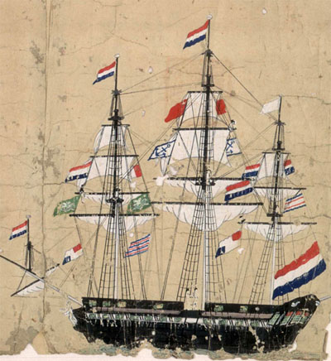
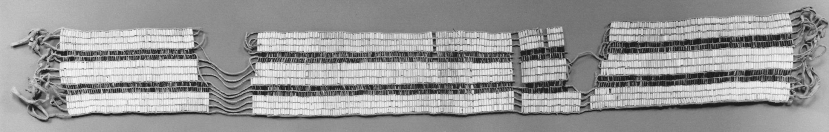
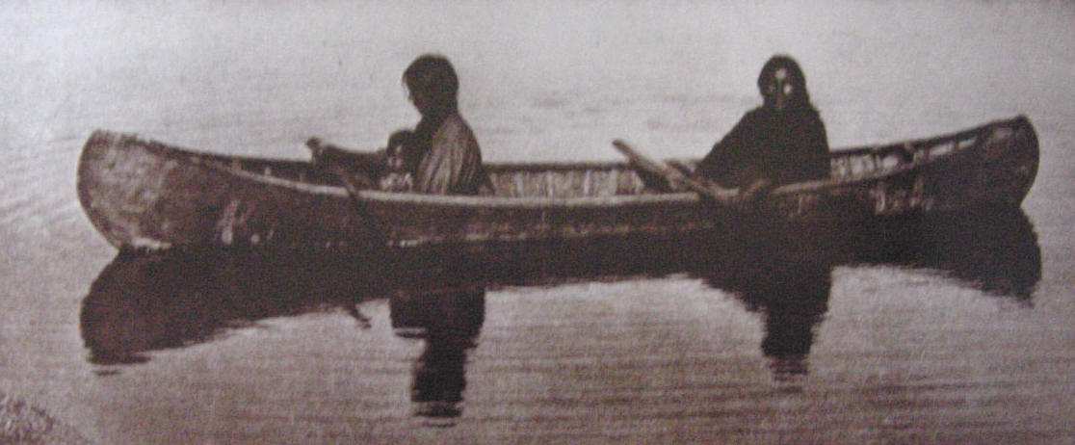

Slide 38
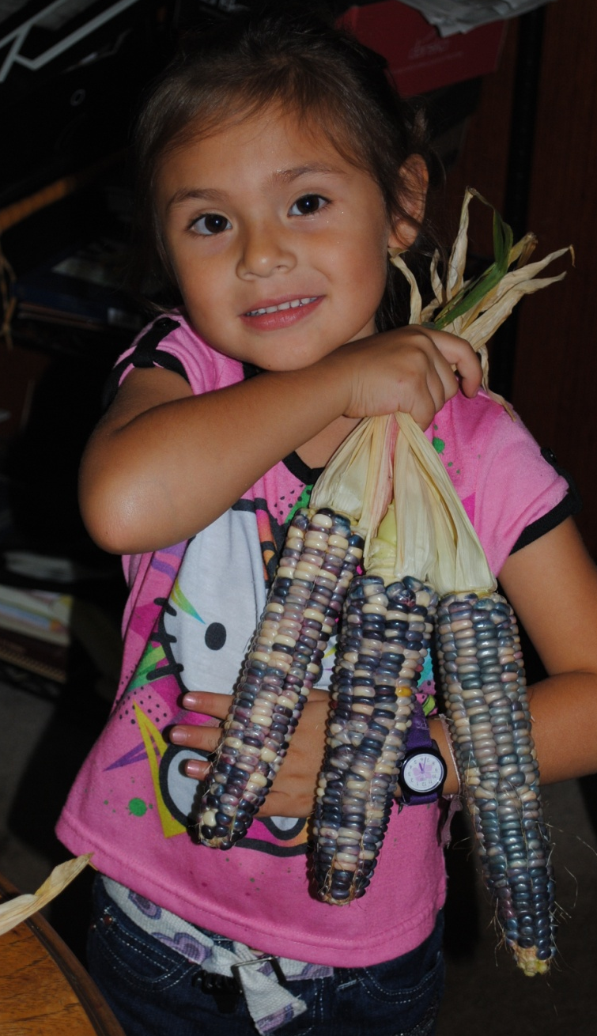
Seven Generations
We are told to think of the impact of our decisions upon the Earth, the Great Peace, and the future generations.
Therefore, we have to ask what are we doing to their soil, their water, their air, their trees, their animals and their chances to live peacefully and healthy.

Slide 39
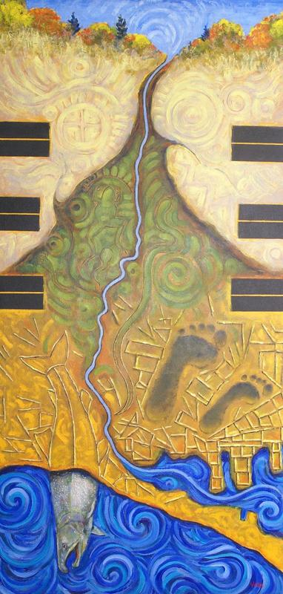
Restoring the Dish
To restore the Dish to its fullest may be impossible, so we have to find creative ways, from both the Ship and the Canoe, to restore our healthy relationship to the Earth, the waters, the trees, the plants, the birds, the animals and the medicine plants.

Slide 40
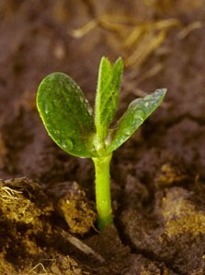
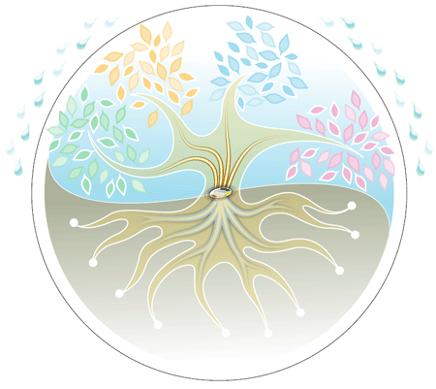
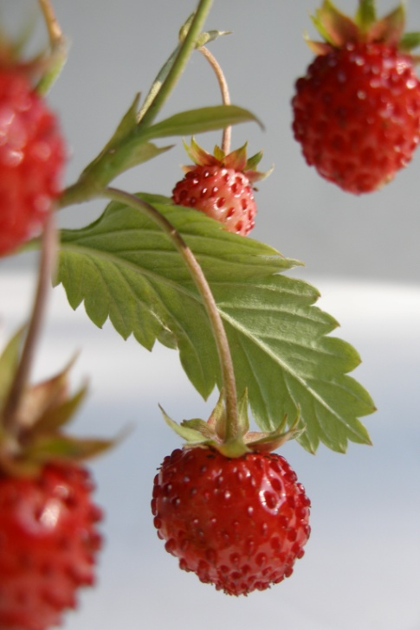
Cycle of Life
Both Science and Indigenous culture respects the cycle of life, they just approach it from different points of view.
Science can benefit from learning more of our relationship with nature, not just our information about nature.

Slide 41
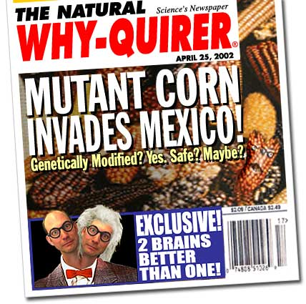
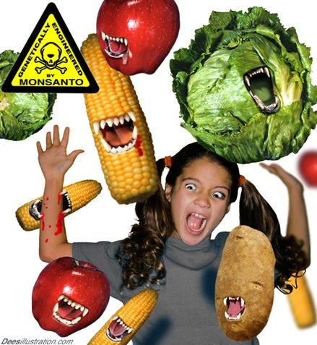
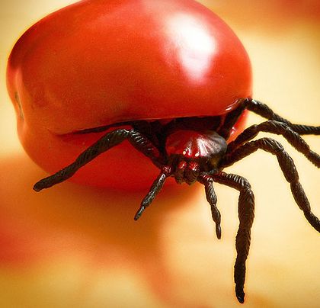
Science to the Rescue
The Mad Scientists have proposed genetically modified foods to protect against disease.
The also add a Terminator Gene so they don’t reproduce, and you have to buy more seeds every year.
What is in these seeds besides profit?

Slide 42

What is Your Belief Systems?
Have you become a Two-Hearted person, fascinated by technology to the point where you do not have much contact with nature?
Is Indigenous Wisdom powerful enough to change our course and steer us away from ecological disaster?

Slide 43

Knowledge and Power
Western civilization, unfortunately, does not link knowledge and morality but rather, it connects knowledge and power and makes them equivalent.
Vine Deloria, Jr.

Slide 44
Knowledge and Morality
As we look around and observe modern industrial society, however, there is no question that information, in and of itself, is useless and that as more data is generated, ethical and moral decisions are taking on a fantasy dimension in which a `lack of evidence to indict' is the moral equivalent of the good deed.

Slide 45


